Slide 1
PROGRAMMING STATUS REPORT
Pre-Thesis Demo
A 1–6 player online co-op psychological horror game
REPORTING WEEK
PRESENTED BY
ENGINE / NET
Week of 8-12 Sep 2026
Mr.k — Head Programmer
Unity 6.5 · Mirror + Epic Online Services
Status: the game is now playable online between two machines.
Notes:
This is the first of a weekly programming report. Headline for this week: the demo crossed from single-machine prototype to a real online session between two clients.

Slide 2
SCOPE
What the demo has to prove
Online co-op, 1–6 players
1
One host, up to five joiners, matched through Epic Online Services — no IP addresses, no port forwarding.
The 13 Rules of Horror
2
A dynamic rule system that changes what is safe to do during a run. This is the design thesis of the game.
Persistent progression
3
Equipment and currency survive between runs, stored encrypted on the player's own machine.
Deliberately out of scope for the demo: multiple maps. One map ships now; the map pipeline is thesis work.
Pre-Thesis Demo | Programming Status Report
01
Notes:
Keep the scope statement visible: one map is a decision, not a shortfall.

Slide 3
PROGRAMMING TEAM
Who writes what
1
Mr.k
2
Sub coder
Head Programmer
Gameplay Programmer
Networking architecture (Mirror + EOS)
Room creation, matchmaking, room browser
Encrypted save / progression system
Offline↔online dual-mode infrastructure
Editor tooling and build health
Integration: making feature code network-safe
Player movement and first-person camera
Interaction system (doors, levers, props)
Health and damage model
Downed / revive system
Gameplay-facing UI behaviour
Where the two meet: gameplay features are written single-player first, then rewritten by the head programmer to run under server authority. That handover is a scheduled step, not a repair.
Pre-Thesis Demo | Programming Status Report
02

Slide 4
HEADLINE
This week the game went online
✓
✓
✓
Rooms
Presence
Sandbox
A host can create a room on EOS and a stranger's client can find and join it.
Two machines now share one world — both player objects spawn on both clients.
Solo test scenes work again without a server, so feature work is not blocked on networking.
Where that leaves the demo
The networking risk — the part of this project that could have failed late and taken the whole demo with it — is now retired. Everything remaining is content and feature work on top of a connection that has been shown to hold.
Pre-Thesis Demo | Programming Status Report
03
Notes:
The three evidence slides that follow correspond one-to-one with these three milestones.

Slide 5
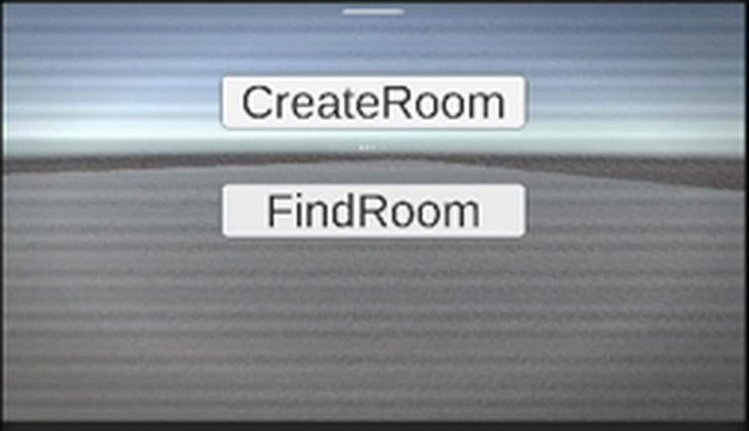
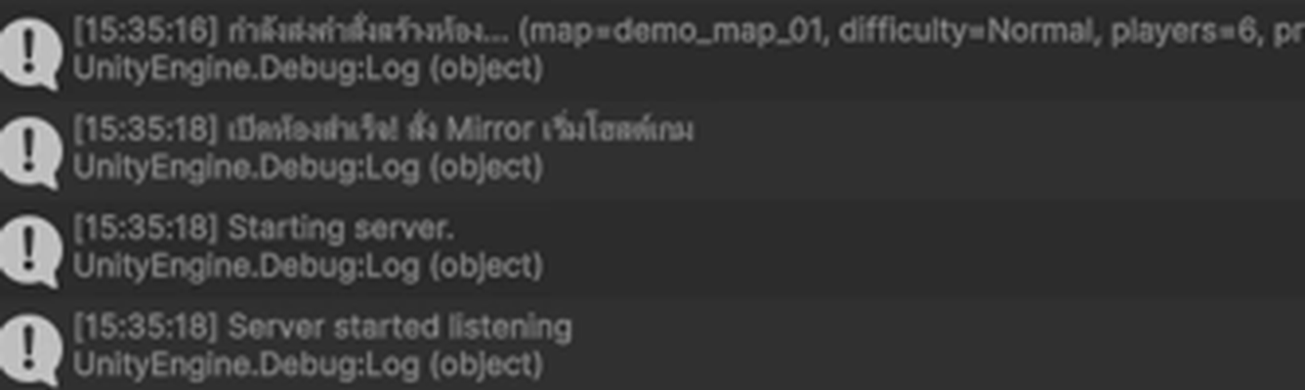
EVIDENCE · PLAYTEST RECORDING
Milestone 1 — rooms on Epic Online Services
Editor console during the run — host side
Room config carried into the lobby:
map = demo_map_01 · difficulty = Normal · players = 6 · private = False
MainMenu — the two entry points under test
Create Room → opens an EOS lobby, then starts the Mirror host
Find Room → searches EOS and returns every open room
Room settings are published as EOS lobby attributes, so the browser can show map, difficulty and player count before joining.
Passwords are deliberately NOT lobby attributes — EOS makes those readable by anyone searching.
Pre-Thesis Demo | Programming Status Report
04

Slide 6
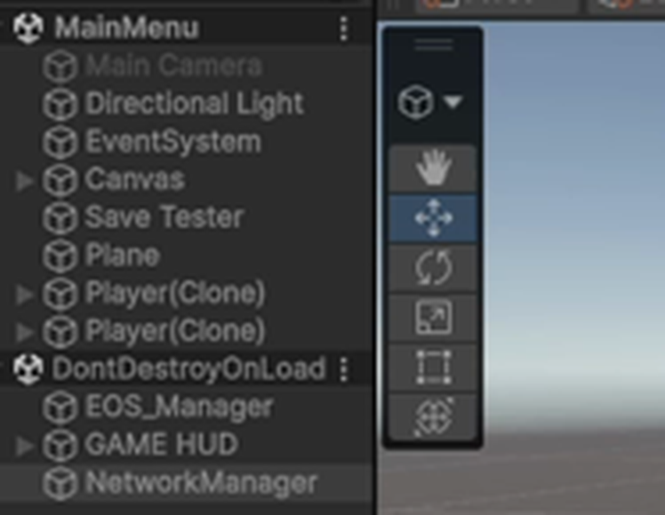
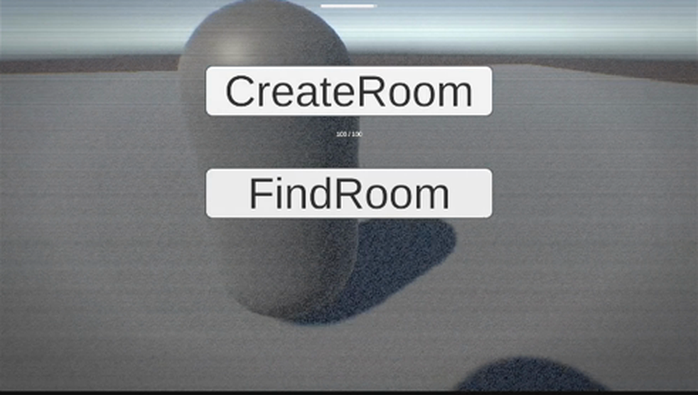
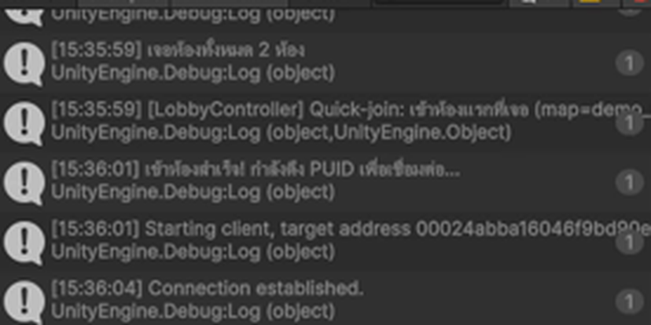
EVIDENCE · PLAYTEST RECORDING
Milestone 2 — two machines, one world
Client connection log
“Connection established”
after the client resolved the host's EOS product user ID.
Host scene hierarchy
Two Player(Clone) objects — the host and the remote client — both live in the same scene.
Game view — the other player is visible and moving
This is the result that was failing last week: the client connected but no player objects appeared. Root cause was a prefab registration mismatch between the two machines' checkouts — now resolved.
Pre-Thesis Demo | Programming Status Report
05

Slide 7
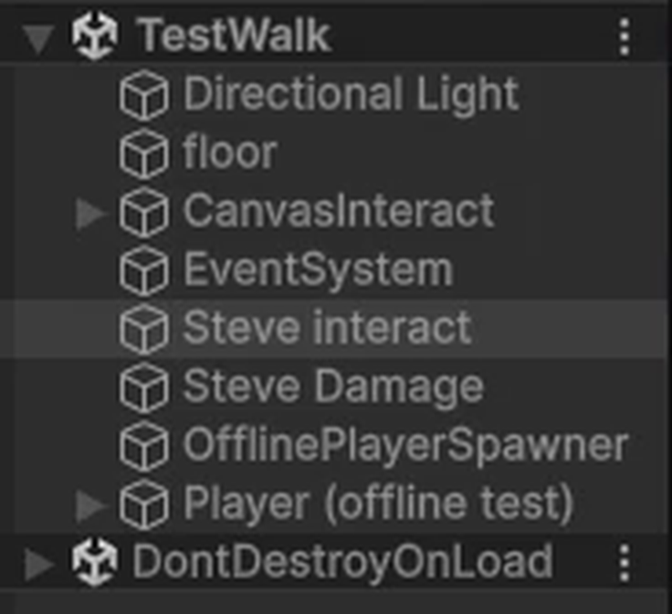
EVIDENCE · PLAYTEST RECORDING
Milestone 3 — solo testing works again
The problem
Mirror force-disables every scene object that carries a NetworkIdentity, so the server can decide when to spawn it. In a sandbox scene there is no server — so interactable props simply disappeared the moment Play was pressed, and feature work could not be tested without hosting a match.
The fix
A dedicated offline mode. When no server and no client are running, a spawner places a player and re-enables the scene objects Mirror switched off. The two earlier attempts failed on timing — Mirror's pass runs after Awake — so the working version watches for several frames instead of guessing the order.
TestWalk in Play mode — nothing has vanished
Editor log confirming the offline spawn
In a real match this code does nothing at all — it is gated on there being no server and no client.
Pre-Thesis Demo | Programming Status Report
06

Slide 8
9B95A2
ARCHITECTURE
The rule every system obeys
The client asks. The server decides. Every client is told.
1
2
3
4
Client
Command
Server
Broadcast
→
→
→
Raycasts, highlights, shows the prompt, reads the key press. Fast and local — never waits on the network.
Sends only which object it wants to use. It never asserts that the action was legal.
Re-checks range and state against its own view of the world, then applies the change.
The new state syncs to every client, including players who join later.
Why it matters for a horror game:
tension only works if the rules are the same for everyone. A client that could decide its own damage, or open a door the server never agreed to, would break the game for the other five players.
Pre-Thesis Demo | Programming Status Report
07

Slide 9
CODEBASE
What exists in code today
21
C# scripts
2,821
lines of C#
11
commits by the head programmer
5
Unity scenes
Counts are working code in Assets/_Script only — third-party packages and generated files excluded.
Pre-Thesis Demo | Programming Status Report
08

Slide 10
ENGINEERING
Problems that were not obvious
SYMPTOM
WHAT WAS ACTUALLY WRONG
RESOLUTION
Two EOS SDKs in one build
Builds failed with colliding native plugins and ~1,000 duplicate-binding warnings.
Two different Epic integrations were installed. Removed the unused one; the build went to 0 errors.
1
Client saw an empty world
The client connected, but no player ever appeared on its screen.
The server can instantiate a prefab it holds a reference to; a client can only spawn one that is registered. The two checkouts disagreed.
2
Props vanished on Play
Interactable objects disabled themselves the moment the scene started.
Mirror force-disables scene NetworkIdentities, and does it after Awake — so an Awake-time fix silently does nothing.
3
Lobby creation rejected
Creating a room returned InvalidUser, seemingly at random.
Epic login is asynchronous. Clicking before login completed sent the request with no identity. Now gated on login state.
4
Common thread: each was found by reading the third-party source rather than guessing at its behaviour.
Pre-Thesis Demo | Programming Status Report
09

Slide 11
STATUS
Health, and what is still open
Build health
Verified this week
0
0
✓
Host creates a room; a second machine finds and joins it
Both players spawn, move, and are visible to each other
Solo sandbox scenes run with no server present
compile errors
C# warnings
Windows build
Open items — carried into next week
Room browser UI
The search returns parsed rooms; nothing draws them yet.
High
No gameplay map
Testing happens in a menu scene with a flat plane.
High
Private-room passwords
Design decided, not yet implemented — must be sent outside the lobby.
Medium
13 Rules system
Not started. This is the design thesis and needs a scheduled slot.
High
Pre-Thesis Demo | Programming Status Report
10

Slide 12
FORWARD
Next week's plan
Head Programmer
Gameplay Programmer
Build the room browser UI on top of the working search
Move the match from the menu scene into a real level scene
Implement private-room password exchange after join
Start the 13 Rules system: state container and sync model
Extend interaction to the equipment the demo needs
Tune the downed / revive timings against playtest feel
Author the props and triggers for the demo map
Reporting cadence
This report is issued weekly from here to submission. Each edition carries the same four sections: what shipped, evidence from playtest, what broke and why, and what is scheduled next.
Pre-Thesis Demo | Programming Status Report
11

Slide 13
Where the project stands
The hardest technical risk is behind us.
Four weeks in, the demo has a working online session, a server-authoritative gameplay layer, an encrypted save system, and a build that compiles clean. What remains is content on top of proven foundations — which is the order a project wants to do things in.
Questions
Pre-Thesis Demo | Programming Status Report
Week of 8-12 Sep 2026

